Slide 1


Vitamin B12 cryst
The biotech pink vitamin for sensitive and stressed skin
December 2021

Slide 2




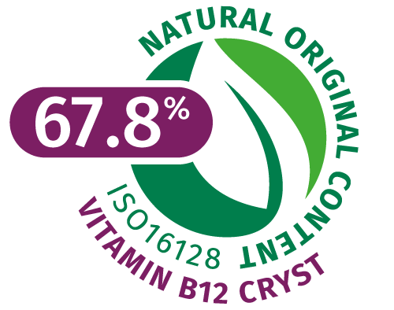

Vitamin B12 cryst 5016420
Identity card
Product features
Cobalamin: one of the most complex vitamin, with Cobalt structure
Cyanocobalamin is converted into adenosyl- cobalamin and methylcobalamin, which are the forms that have physiological activity
Red-pink color
Water soluble B vitamin
Natural source: liver, egg, dairy products, fish, meat, algae (nori),…
INCI name
Cyanocobalamin
Manufacturing process
Produced by non-GMO bacterial fermentation
Naturality
67.8% natural origin index (based on renewable carbon according to ISO 16128)

Slide 3

Vitamin B12 cryst 5016420
Soothes and regenerates sensitive skin, making it look more vibrant
Consumer benefits
Vitamin B12 relieves sensitive and stressed skin
Dermatological treatments for skin conditions like itchy, dry, inflamed, red and cracked skin
Helps prevent photo-damaged skin
Protects the skin barrier damage induced by inflammation
Plays an important part in speeding up cell recovery and regeneration
skin looks more vibrant
Nice pink color of the formulations
Use level
From 0.001% to 0.1%

Slide 4
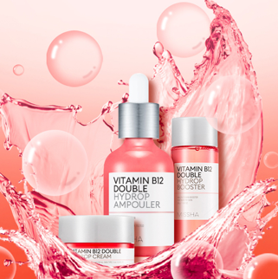
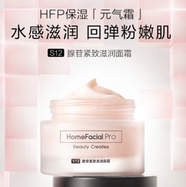
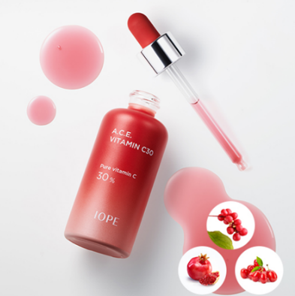
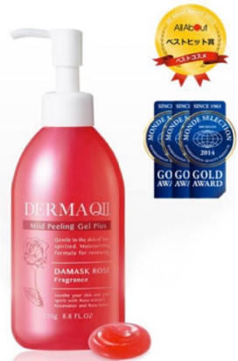
Vitamin B12: the new trendy ingredient!
Particularly in Asia
Korea:
Missha Vitamin B12 double hydrop set: skin hydration. Vitamin B12 for replenishing moisture and energy for the skin, with multi-vitamins cocktail B3, B5, A, C and E
China
HomeFacialPro Adenosine serum& cream. Vitamin B12 accelerates renewal and revitalizing, relieves skin fatigue, dull, dry and other problems
Korea
Amore Pacific IOPE brand. Anti-aging red ampoule with Vitamin C 30%, Vitamin B12 and Vitamin B3
Japan
Derma QII Mild Peeling Gel. An exfoliation gel that gently removes built-up dead skin cells, leaving your skin soft and smooth

Slide 5
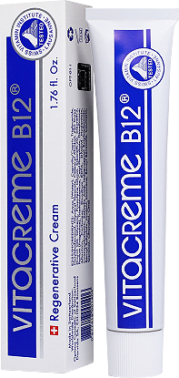
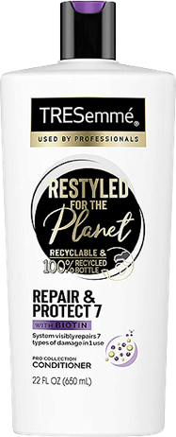
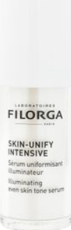
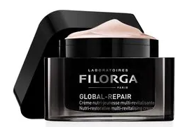
Vitamin B12: the new, trendy ingredient!
As well as in Western countries
France
Filorga Global repair. Nutri-restorative multi revitalizing cream
France
Filorga skin unify intensive. To provide unifying, illuminating, anti-dark spot effects
UK
Unilever Tre Semmé brand hair conditioner. Repairs seven types of damage in 1 use: blow-drying, straightening, coloring, curling, bleaching, brushing and braiding
Switzerland
Darvidis Vitacreme B12 regenerative cream. Prevents and fights effectively against signs of aging

Slide 6
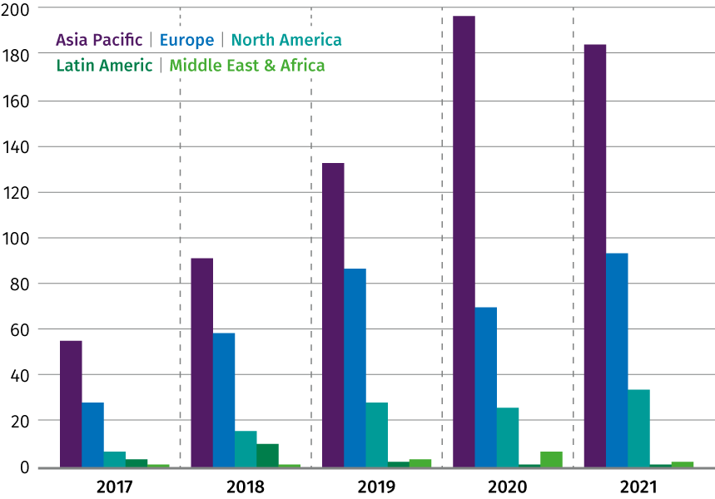
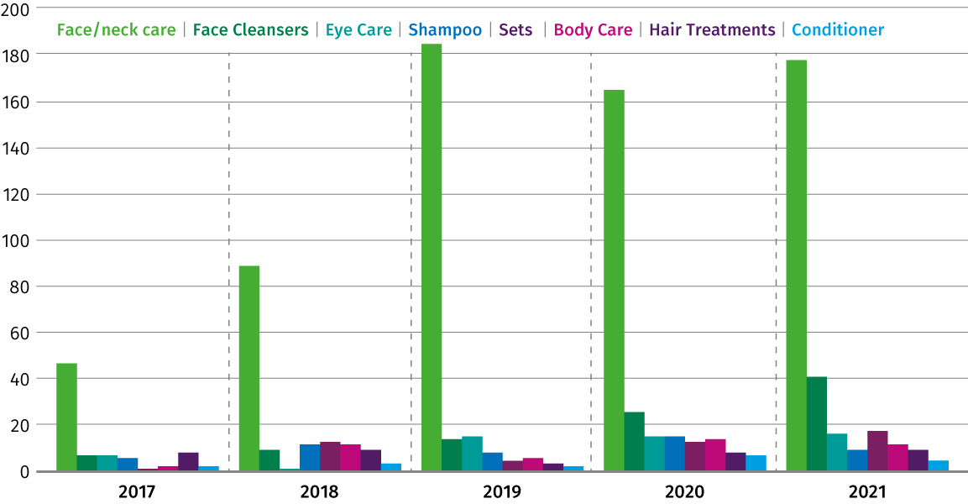
Vitamin B12: the new, trendy ingredient!
Still a fairly low number of launches with Vitamin B12, but it gains traction
Total BPC launches with Cyanocobalamin as ingredient:
Per region
Per category
Continuous growth of total of launches within BPC where Asia is the leading region followed by Europe. The application most used is face care, far ahead of hair and body care

Slide 7

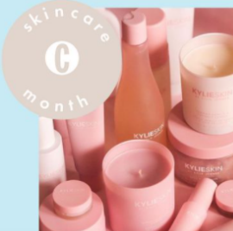



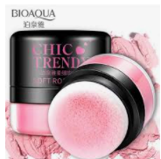
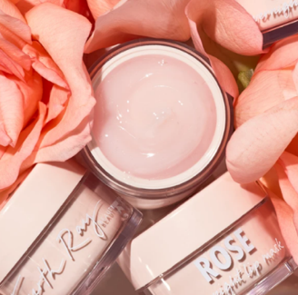
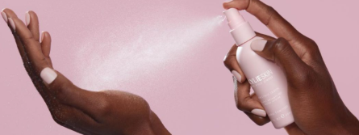
Vitamin B12 is used as naturally derived colorant
Pink is a trendy color in cosmetics/skin care
Pink is a universally flattering color — it works to bring out the natural flush in your cheeks and warms up the face
Cosmopolitan 07/2021
Source: www.Pinterest.com, www.goodhousekeeping.com

Slide 8


Pink/purple: the third preferred color
Violet / purple relates to the crown chakra which is at the top of the head and considered the seventh primary chakra in some yoga traditions.
The Top 5 Most Loved Colors: Purple came 3rd with 19% of preferences – just behind green (34%) and blue (35%)¹
Influence of pink color on emotions:
Pink is a color with many positive virtues: a nurturing pink hue can both soothe & calm the mind & body
Pink naturally cleanses the body’s blood and cleanses the mind of impure thoughts
Edwin Babbitt, pioneer of the modern chromotherapy, identified violet as soothing to all systems and as having anti-inflammatory properties³
Pantone released its color trend report for spring / summer 2022: Bubble gum
It sends a message of playfulness and positivity²
Perfect match between the influence of pink color on the body and the scientific evidences of Vitamin B12 as skin soothing
https://medium.com/illumination/the-top-5-most-loved-colors
https://www.pantone.com/articles/fashion-color-trend-report/london-fashion-week-spring-summer-2022
Principles of Light and Color. MT, USA: Kessinger Publishing; 1942. Evid Based Complement Alternat Med > v.2(4); 2005 Dec

Slide 9

Vitamin B12 cryst
Already efficient known biological activities
Involved in cell metabolism, cofactor in DNA synthesis
Coenzyme for isomerase, methyltransferase and dehalogenase involved in protein and lipids synthesis
Vitamin B12 deficiency causes: skin hyperpigmentation; atopic dermatitis; Erythema nodosum; vitiligo, glossitis; hair and nail changes
Hyperpigmentation: first sign of vitamin B12 deficiency, shows increased melanin in the basal layer of the epidermis (in melanocytes and surrounding keratinocytes)
Atopic dermatitis: in vitro, vitamin B12 is able to suppress the cytokine production of T lymphocytes, which may initiate the inflammatory events of atopic dermatitis.
Vitamin B12 is effective as nitric oxide scavenger, and NO in excessive amount is known to cause itching and redness in eczema
Sources: Am J Clin Dermatol (2015) 16 (1) 27–33; Brit J Dermatol (2004) 150: 977-983

Slide 10
Vitamin B12 Cryst.
New DSM scientific discoveries on anti-inflammatory properties and healthy Microbiome

Slide 11



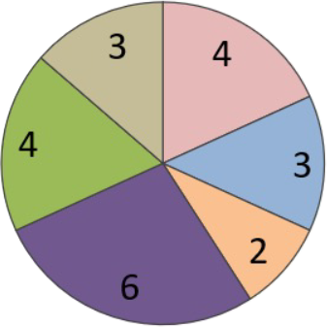

Vitamin B12 cryst: epigenetic screening
Epigenetic regulators (miRNA) modulated by Vitamin B12 on primary human keratinocytes: especially on anti-inflammatory activity
miRNAs modulated by Vitamin B12
With a screening on qPCR-based gene expression panel of 105 miRNAs, we have identified 22 miRNAs significantly modulated by 0.004% Vitamin B12, in particular miR-22-3p
miR-22-3p plays a role in:
Inhibiting messenger RNA and protein expression of NLRP3 and thus reduce inflammasome activity
Inhibiting the NRLP-mediated activation of Caspase 1 (enzyme that cleaves pro-IL-1β and pro-IL-18 into active forms, initiating an inflammatory cascade)
Vitamin B12 produced a statistically significant increase in expression in microRNAs
microRNA | Fold-change value
miR-22-3p | 2.02-fold increase
Antioxidant response / inflammation
UV (UVA or UVB) response
Pigmentation / whitening / melanogenesis
Wound healing / proliferation / angiogenesis
Differentiation / barrier functions
Senescence / cell cycle / cell survival
NLRP3: Nucleotide-binding domain, Leucine-rich Repeat family Pyrin domain containing 3
IL1-ß: Interleukin 1ß, IL18: Interleukin 18
Source: Hu Z. et al., Protective effects of microRNA-22-3-p against retinal pigment epithelial inflammatory damage by targeting NLRP3 inflammasome, J. Cell Physiol. 2019, 234:18849-18857

Slide 12
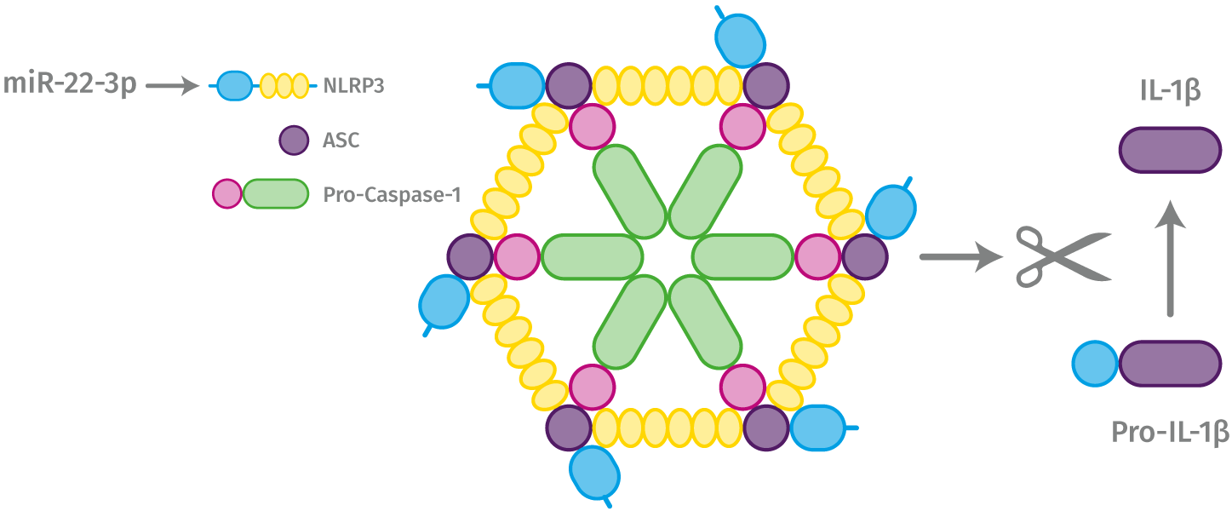
Mechanism of skin inflammatory reactions: Inflammasome in keratinocytes is a key element
NLRP3-Inflammasome activation
miR-22-3p, as gene blocker, is the regulator of the inflammasome
ASC recruits Caspase-1 to the complex forming the inflammasome
Inflammasome is intracellular multiprotein (NRPL3, ASC and Pro-Caspase-1) complex
Inflammation
Redness Irritation Itching Sensitive skin
UV
Pollution
Oxidative stress
Action of Vitamin B12
UV, pollution or any oxidative stress induce the formation of the NLRP3-inflammasome, especially in keratinocytes. This inflammasome is responsible for regulating the immunological response, triggers the inflammatory response by cytokines production such as IL-1b and IL-18. If it gets chronically activated, it causes skin irritation and premature aging.
Vitamin B12 upregulates miR-22-3-p which is the inhibitor of the NLRP3-inflammasome, reduces the ASC complex activation and finally slows down the cleavage of pro-IL1ß into active form
ASC: Apoptosis-associated Speck-like protein containing a Caspase recruitment domain
NLRP3: Nucleotide-binding domain, Leucine-rich Repeat family Pyrin domain containing 3
Source: Bauernfeind F. et al., NLRP3 inflammasome activity is negatively controlled by miR-223, The Journal of Immunology, 2012, 189: 4175:4181
Notes:
The term ‘NLRP3’ refers to the ‘NOD-like receptor family pyrin domain containing 3’. NLRP3 is a component of the innate immune system that functions as cytoplasmic sensor that recognizes pathogen- and damage-associated molecular patterns. When NLRP3 recognizes its ligand, it recruits an adaptor, apoptosis associated speck containing a caspase activation and recruitment domain (ASC). NLRP3 together with the adaptor ASC protein forms a caspase-1 activating complex known as the NLRP3 inflammasome. The NLRP3 inflammasome cleaves and thus activates caspase-1 which in turn can initiate the maturation of interleukin 1 β (I L-1 β) and IL-18 by cleaving their inactive precursors. Activation of these interleukins allows to activate the inflammatory pathway of cell death, called pyroptosis.

Slide 13
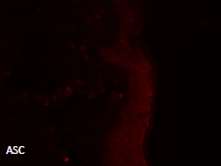
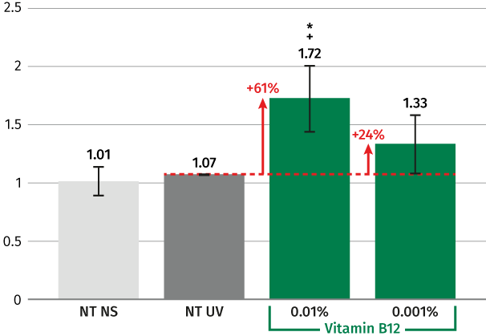
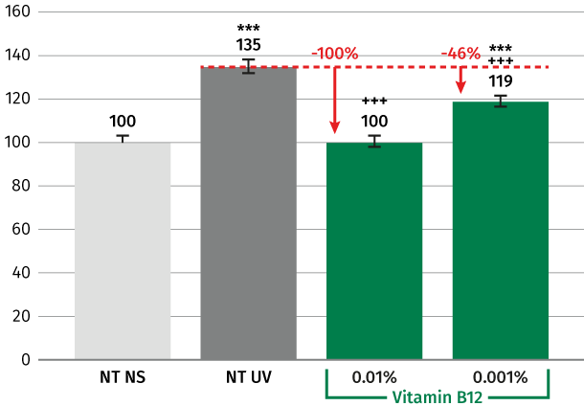
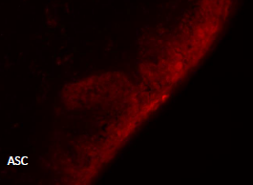
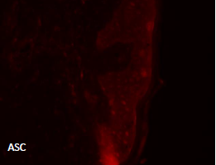
DSM scientists discovered for the first time that Vitamin B12 reduces the inflammasome activation
Vitamin B12 reduces UV-B induced inflammasome activation ex-vivo
NS
Vitamin B12 significantly up regulates by 61% miR-22-3p at 0.01%
Vitamin B12 significantly down regulates ASC complex activation by 100%, to the level of non-treated, at 0.01% after UV-B stress
miR-22-3p expression after UV stress
Mean ASC intensity
UV
* Stat vs NT NS p<0.05
+ Stat vs NT UV p>0.05
B12 0.01%
*** vs NT NS p<0.001 +++ vs NT UV p<0.001
Female donor 52 yo Caucasian. Vitamin B12 before and after UV-B irradiation. Day 1: skin explant culture – Day 2: UV stress – Day 3: biomarker testing
ASC: Apoptosis-associated Speck-like protein containing a Caspase recruitment domain

Slide 14

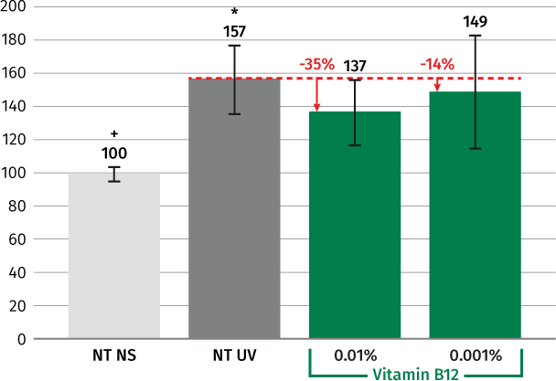
Vitamin B12 reduces the pro-inflammatory cytokine IL-1 beta after UV-B stress ex-vivo
* Stat vs NT NS p<0.05
+ Stat vs NT UV p>0.05
Vitamin B12 reduces the increase of IL1-beta production after UV-B stress by 35% at 0.01%

Slide 15
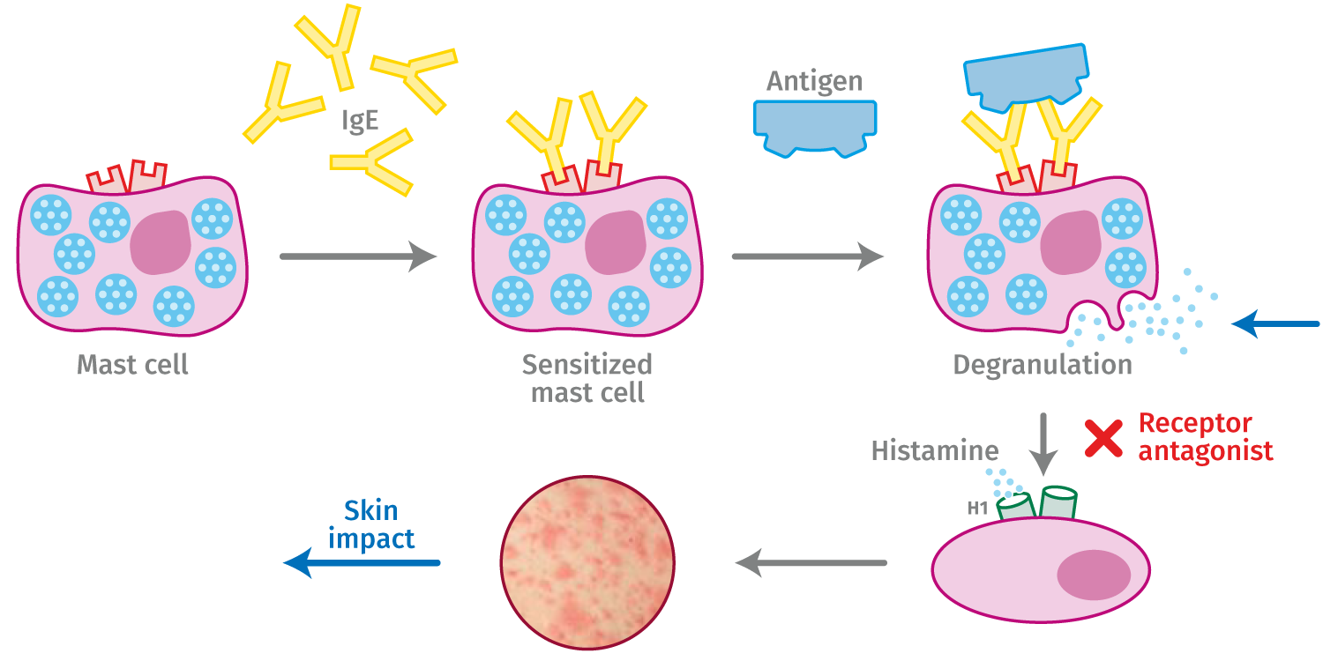
Inflammation: Mast Cell degranulation
Leads to itching, irritated, red and sensitive skin
Mechanism of action of mast cell degranulation and inhibition of histamine release
Mast cells can be activated by environmental stress factors like allergens, UV light, pollution and free radicals
Degranulation is the release of mediators such as histamine, cytokines, proteases,…
Vitamin B12 to block mast cell degranulation
Proinflammatory mediators
Itching, stinging, burning, redness, dry & sensitive, atopic dermatitis
IgE: immunoglobulin E: type of antibody triggering allergies

Slide 16
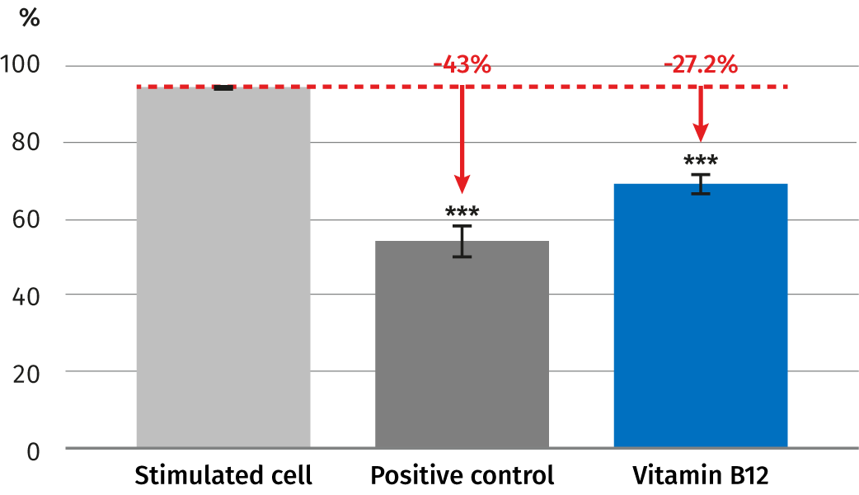
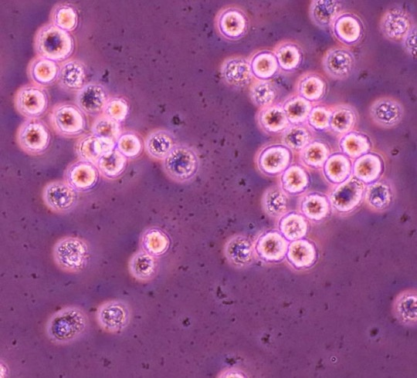
First discovery: Vitamin B12 reduces histamin by inhibiting mast cell degranulation in vitro
Degranulation rate
Vitamin B12 significantly inhibits mast cell degranulation by 27% at 0.00015%.
it helps to protect inflammation induced skin barrier damage and relieves sensitive and irritated skin
No degranulation occurred
Degranulation
*** p-value<0.001
Mast cells incubated for 24 hours then Vitamin B12 was added. Then, after another hour, C48/80 (a polymer that promotes histamine release and mast cell degranulation at 50ul/mL) was added and incubated for one final hour. Cell morphology was assessed by microscope. Cromolyn sodium at 1mg/Ml was used as positive control

Slide 17
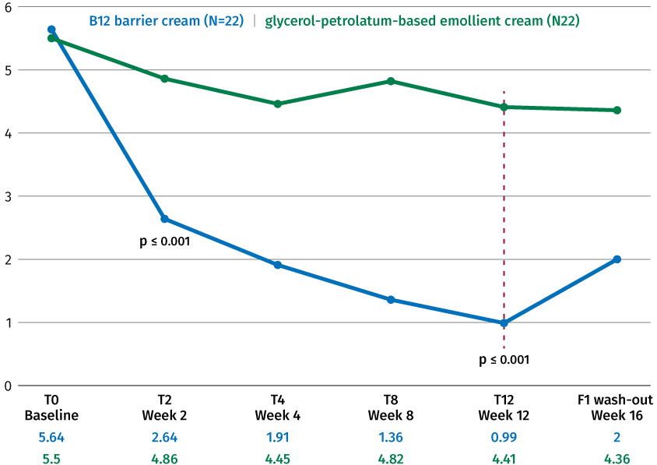
Vitamin B12 cryst: Atopic dermatitis
Vitamin B12 significantly reduces all symptoms related to atopic dermatitis such as pruritus in vivo
Absolute SCORAD
Vitamin B12 showed in 100% of cases significant lower values of SCORAD index after 12 weeks
Significant reduction on erythema with high level of tolerability in all patients
Topical application is the most appropriate way of administration to reach peripheral target
2x 22 subjects, male and female, with mild AD
0.07% vitamin B12, hemi-body application, 2-3 times a day vs placebo
12 weeks treatment + 4 weeks
SCORAD (SCOring Atopic Dermatitis): clinical tool to assess the severity of atopic dermatitis on 3 dimensions: area, intensity (redness, swelling, scratch marks, dryness,…, subjective symptoms (itch, Sleeplessness)
Nistico S.P. et al, Dermatologic Therapy, 2017;30:e12523

Slide 18


Vitamin B12 cryst
Formulation guidelines
Easy-to-use
Sparingly soluble in water, slightly soluble in ethanol, insoluble in lipophilic components
Can be used for different kinds of leave-on and rinse-off products like O/W, W/O or W/Si formulations, cream gel, clear gel, shower gel, shampoo, body wash
To be incorporated into the aqueous phase at any time (<80°C)
Is sensitive to high temperature storage and day light. It is recommended to add a chelating agent (such as sodium phytate, Etidronic Acid, Disodium EDTA). For better stability at 50°C sodium gluconate or glycine could be added
Recommended pH of the final formulation: 3.5–7.5
Perfectly fitting to any natural formulations
Use level: 0.001–0.1%
Vitamin B12 cryst In O/W emulsion
0%
0.001%
0.005%
0.01%
0.02%
0.03%
0.04%
0.05%
Vitamin B12 cryst in water solution
0.04%

Slide 19
Soothing Soft Polar Cream
With TILAMAR® PDO with NØØVISTA™, ARGAN OIL, AMPHISOL® K, D-Panthenol 75 and Vitamin B12 cryst
 | INGREDIENTS | INCI NAME | % w/w
A | Water Dem | AQUA | 42,460
 | SODIUM GLUCONATE GRANULAR | SODIUM GLUCONATE | 0,200
 | Biomer | POTATO STARCH MODIFIED | 0,500
 | TILAMAR® PDO with NØØVISTA™ | PROPANEDIOL | 30,000
 | Dermosoft® Octiol | CAPRYLYL GLYCOL | 0,200
B | TEGO® CARE 450 MB | POLYGLYCERYL-3 METHYLGLUCOSE DISTEARATE | 3,000
 | TEGIN® M Pellets MB | GLYCERYL STEARATE | 2,000
 | Lanette® 18 | STEARYL ALCOHOL | 1,000
 | Cetiol® 868 | ETHYLHEXYL STEARATE | 7,000
 | Cetiol® SN | CETEARYL ISONONANOATE | 7,000
 | ARGAN OIL | ARGANIA SPINOSA KERNEL OIL | 0,500
 | Xiameter PMX-200 Sil Fluid 100 CS | DIMETHICONE | 2,000
 | AMPHISOL® K | POTASSIUM CETYL PHOSPHATE | 0,500
C | D-Panthenol 75 L | PANTHENOL, AQUA | 3,000
 | Vitamin B12 cryst | CYANOCOBALAMIN | 0,010
 | Perfume Sail Away 49454695 | PARFUM | 0,500
D | Citric Acid 10% Solution | CITRIC ACID, AQUA | 0,130
89.33% natural origin content according to ISO 16128
This innovative trendy texture stays as a cream even at freeze storage thanks to the high level of TILAMAR® PDO with NØØVISTATM, stabilized by AMPHISOL® K. The after feel is light with pleasant soft cocooning film on skin.
Once put in the freezer, this soft polar cream delivers an immediate cooling effect on the skin and a long-lasting effect, with Vitamin B12 cryst and D-Panthenol 75 L, which helps to sooth and hydrate dry, itchy, irritated and cracked skin.
Procedure
Premix Water and sodium gluconate under stirring.
Sprinkle Biomer under stirring and mix until a clump free gel is obtained.
Premix Propanediol and Caprylyl Glycol and add into phase A under stirring
Heat phase A up to 75°C under stirring
Mix and heat Phase B up to 80°C under stirring​
Add phase B into phase A and homogenize with an Ultra-Turrax. The formulation thickens during the emulsification step
Let cool down to room temperature under stirring with a defloculeuse.​
Below 35°C, add the ingredients of phase C one by one​
Adjust the pH around 5.50 if necessary
SK E 101731 9
19

Slide 20
Vitamin B vibrant booster
With TILAMAR® PDO with NØØVISTA™, VALVANCE® Touch 210, Niacinamide PC,
D-Panthenol 75 L, B6 and Vitamin B12 cryst
 | INGREDIENTS | INCI NAME | % w/w
A | Water Dem | AQUA | 78,490
 | Ecogel™ | LYSOLECITHIN, SCLEROTIUM GUM, PULLULAN, XANTHAN GUM | 2,500
 | TILAMAR® PDO with NØØVISTA™ | PROPANEDIOL | 3,000
 | Dermosoft® Octiol | CAPRYLYL GLYCOL | 0,200
 | Cosphaderm® Pentiol natural | PENTYLENE GLYCOL | 3,000
B | Myritol® 318 | CAPRYLIC/CAPRIC TRIGLYCERIDE | 5,000
 | Perfume Fleur de peau RS90514 | PARFUM | 0,150
C | VALVANCE® Touch 210 | SILICA | 1,000
D | Niacinamide PC | NIACINAMIDE | 4,000
 | D-Panthenol 75 L | PANTHENOL, AQUA | 2,000
 | PYRIDOXINE HYDROCHLORIDE | PYRIDOXINE HCL | 0,200
 | Vitamin B12 cryst | CYANOCOBALAMIN | 0,010
E | Sodium Hydroxide 10% Solution | SODIUM HYDROXIDE, AQUA | 0,450
93.88% natural origin content according to ISO 16128
Vitamin B cocktail with vitamin B3, B5, B6 and B12 cryst introduced in a color stable pink cream gel with a nice texture. VALVANCE® Touch 210 provides a soft after feel.
This well-balanced mix of vitamins B help soothe, clear and moisture the skin, plump fatigued skin and deliver a glow and healthy skin complexion
Procedure
Mix phase A and heat under stirring to 75-80°C
Let stir for 30 min at 75-80°C
Mix phase B and add it to phase A
Add phase C to phase A+B and homogenize 2 min at 18'000 rpm
Let cool down to ±35°C while stirring
Add ingredients of phase D one by one under stirring
Adjust the pH with phase E to around 7
SK E 101720 10
20

Slide 21
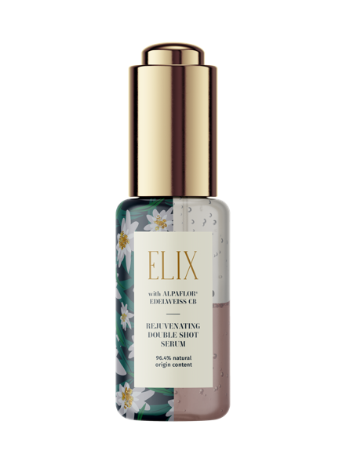
Rejuvenating double shot serum
With TILAMAR® PDO with NØØVISTA™, Vitamin B12 cryst, ALPAFLOR® EDELWEISS CB, HYA-ACT ™ M, Niacinamide PC, PENTAVITIN® and Mixed Tocopherols 95
 | INGREDIENTS | INCI NAME | % w/w
A | Water Dem | AQUA | 26,17
 | Cosphaderm® Pentiol natural | PENTYLENE GLYCOL | 3,00
 | TILAMAR® PDO with NØØVISTA™ | PROPANEDIOL | 20,00
 | SODIUM GLUCONATE GRANULAR | SODIUM GLUCONATE | 0,20
 | Vitamin B12 cryst | CYANOCOBALAMIN | 0,003
 | Dermosoft® 700 B | LEVULINIC ACID, SODIUM LEVULINATE, GLYCERIN, AQUA | 1,00
 | ALPAFLOR® EDELWEISS CB | LEONTOPODIUM ALPINUM FLOWER/LEAF EXTRACT, GLYCERIN, AQUA, CITRIC ACID | 3,00
 | Totes Meer Badesalz (Dead Sea Salt) | MARIS SALT | 2,50
 | HYA-ACT™ M | SODIUM HYALURONATE | 0,12
 | Niacinamide PC | NIACINAMIDE | 3,00
 | PENTAVITIN® | SACCHARIDE ISOMERATE, AQUA, CITRIC ACID, SODIUM CITRATE | 0,50
B | Cetiol® CC | DICAPRYLYL CARBONATE | 10,00
 | Mixed Tocopherols 95 | TOCOPHEROL | 0,50
 | Neossance™Squalane | SQUALANE | 10,00
 | Cetiol® OE | DICAPRYLYL ETHER | 10,00
 | Cetiol® Ultimate | UNDECANE, TRIDECANE | 10.00
96.40% natural origin content according to ISO 16128
Boost your skincare routine with this concentrated serum. Intensive rejuvenating effect, this bi-phase, with ALPAFLOR® EDELWEISS CB and Vitamin B12 cryst providing a nice pink color, gently reduces the appearance of the signs of aging, to reveal a smooth, fully hydrated and radiant complexion with PENTAVITIN®, Niacinamide PC and TILAMAR® PDO with NØØVISTA™, without listed preservative.
Shake vigorously prior to use it, leaves a fresh, silky, soft feel
Procedure
Mix A at room temperature and stir until all is dissolved
Add the Vitamin B12 as pre-dissolved solution in water
Mix B and stir until all is dissolved
Weigh the appropriate quantities of both phases separately
Shake vigorously to use it
SK-E-101867-46
21

Slide 22
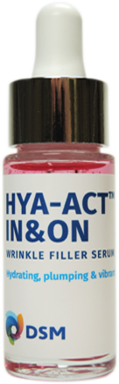
HYA-ACT™ IN & ON wrinkle filler serum
With TILAMAR® PDO with NØØVISTA™, Vitamin B12 cryst, HYA-ACT™ M, S and XS
 | INGREDIENTS | INCI NAME | % w/w
A | Water Dem | Aqua | 88,780
 | Sodium Gluconate granular | Sodium Gluconate | 0.200
 | Dermosoft® Octiol | Caprylyl Glycol | 0.200
 | Eumulgin CO 60 | PEG-60 Hydrogenated Castor Oil | 0.300
B | TILAMAR® PDO with NØØVISTA™ | Propanediol | 3.000
 | Cosphaderm Pentiol natural | Pentylene Glycol | 3.000
 | SYN®-HYCAN | Glycerin, Aqua, Magnesium Chloride, Tetradecyl Aminobutyroylvalylaminobutyric Urea Trifluoroacetate | 2.500
C | HYA-ACT™ M | Sodium Hyaluronate | 0.500
 | HYA-ACT™ S | Sodium Hyaluronate | 0.500
 | HYA-ACT™ XS | Hydrolyzed Hyaluronic acid | 0.500
D | Vitamin B12 cryst | Cyanocobalamin | 0.005
 | Water Dem | Aqua | 0,495
E | Citric Acid | Citric acid, Aqua | 0.020
99.47% natural origin content according to ISO 16128
This lightweight serum contains a balanced mix of HYA-ACT™ M, HYA-ACT™ S and HYA-ACT™ XS and works with our unique peptide SYN®-HYCAN, Vitamin B12 cryst and TILAMAR® PDO with NØØVISTA™ to help smooth wrinkles, plump tired skin and deliver a vibrant looking complexion, all in a luxurious texture.
Procedure
Pre-mix phase A and stir until a homogenous solution is obtained
Add phase B
Add ingredients of phase C one after the other. Add them in portions to avoid lumps. Let stir with a turbine stirrer until a homogenous solution is obtained
Add solution of Phase D
Adjust the pH to 5.5 with phase E
SK E 101690 14
22

Slide 23

Vitamin B12 cryst 5016420
The biotech pink vitamin for sensitive and stressed skin
Unique Product Features
Biotech naturally derived pink vitamin
Active on atopic dermatitis, reducing erythema and pruritus in vivo
Prevents inflammation ex vivo: significant and strong reduction of inflammasome and inflammatory cytokines such IL1-ß.
Epigenetic regulation of inflammasome: over-expression by 61% of miR-22-3p with vitamin B12 at 0.01% leads to a reduction of inflammasome ex vivo
Significantly reduction of Mast cell degranulation by 27%, drops the histamine release in vitro
Consumer Benefits
Vitamin B12 relieves sensitive and stressed skin
Helps relieve skin conditions like itchy, irritated, inflamed, red and cracked skin
Helps prevent photo-damaged skin
Protects the skin barrier damage induced by inflammation
Plays an important part in speeding up cell recovery and regeneration
skin looks more vibrant
Provides a nice and pleasant pink color of the cosmetic products

Slide 24
DISCLAIMER
Copyright © 2021 DSM Nutritional Products, 4002 Basel, Switzerland.
www.dsm.com/personal-care. All rights reserved.
Although DSM has used diligent care to ensure that the information provided herein is accurate and up to date, DSM makes no representation or warranty of the accuracy, reliability, or completeness of the information. This presentation only contains scientific and technical information for business to business use. Country- or region-specific information should also be considered when labeling or advertising to final consumers. This publication does not constitute or provide scientific or medical advice, diagnosis, or treatment and is distributed without warranty of any kind, either expressly or implied. In no event shall DSM be liable for any damages arising from the reader’s reliance upon, or use of, these materials. The reader shall be solely responsible for any interpretation or use of the material contained herein. The content of this document is subject to change without further notice. Please contact your local DSM representative for more details. All trademarks listed in this brochure are either registered trademarks or trademarks of DSM in The Netherlands and/or other countries unless explicitly otherwise stated.
DISCLAIMER FORMULATION GUIDELINES
This information is for illustration purposes only and based upon our current knowledge and experience at the time of printing. We do not make any representation or warranty of any kind, express or implied, including merchantability or fitness for a particular use, with respect to such information or its application. Use of this information is at your discretion and risk. Nothing herein relieves you from carrying out your own suitability determinations and tests. You are responsible for observing all laws and regulations relevant to your products, uses or processes. We do not assume any liability in connection with your product and its use. The foregoing information and suggestions are also provided without warranty of non-infringement as to the intellectual property rights of third parties, and shall not be construed as any inducement to infringe the rights of third parties.
This document only contains scientific and technical information for business-to-business use. Country or region-specific regulatory requirements should be considered when developing claims for labeling or advertising to final consumers.

Slide 25


DSM’s Vitamins promise
Today, we are adding value to our DSM trusted heritage in vitamins
Quality
Quality is the cornerstone of our delivering. You can trust DSM to bring you products that are consistent in quality and high in purity.
Reliability
Our vitamins are reliable, meaning they will consistently deliver on their intended use — whether it is your skin cream, the milk you pack in your child’s lunch or the daily supplement you take to help ensure optimal nutrition.
Traceability
Our ability to track and verify the quality of our products throughout their life cycle is what makes traceability essential to answer the clean beauty.
Sustainability
Quality extends beyond products and services and includes our commitment to the environment, which we show by reducing the environmental impact of our activities while simultaneously optimizing land and resource use.
Our Vitamins that are not only of the highest quality, totally reliable and fully traceable, but have minimum impact on the planet
Notes:
DSM‘s commitment to creating a safer, fully traceable, more reliable and sustainable business
At DSM, we are committed to living up to our strong promise in the areas of quality, reliability, traceability and sustainability
Quality:
It’s about product and being consistent in quality and high in purity. It’s all about systems and processes (25mio € Investement in GMP, zoning concept in Sisseln and Dalry). It’s a spirit: striving for lower impurities, tighter specs (like we do for panthenol). Quality is also a service (trends, CDC)
A multilayered quality management system lies at the core of our business. The Quality for Life™ seal offers tangible certification of superior products and services that meet quality and safety standards.

Slide 26
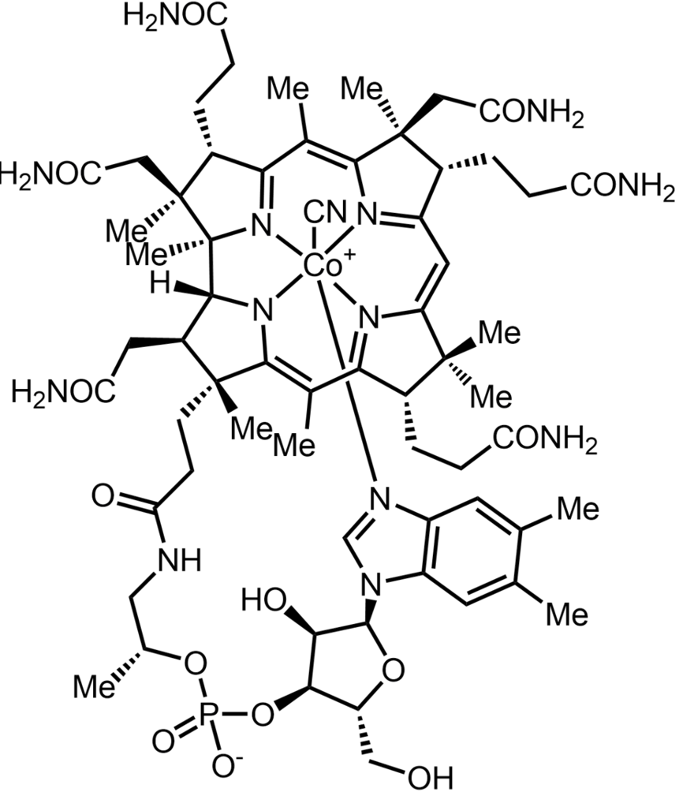
Vitamin B12: one of the most complex structure
Cyanocobalamin biosynthesis 5016420
Fermentation
(non-GMO bacteria)
Purification
Corn syrup
From non-GMO corn
Ex China
Crude
Cyanocobalamin
Vitamin B12
cryst
NaCN
Chromatography
Crystallization
Betain
5,6 DiMethylBenzimidazole
Cobalt (mineral)
C₆₃H₈₈CoN₁₄O₁₄P

